Slide 1
Portfolio Optimization Using No-Regret Online Learning: A Case Study on US Stocks

Slide 2
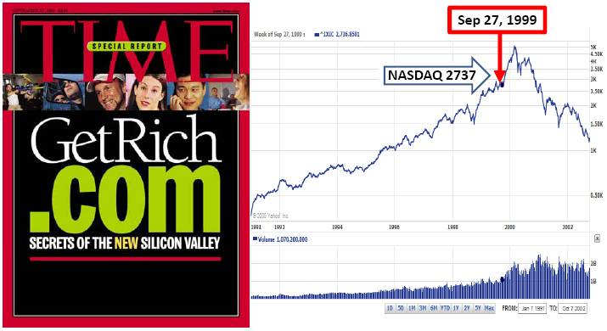
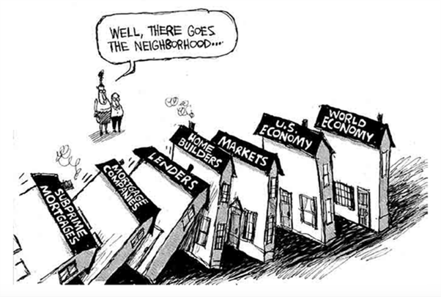
Motivation
The recommended investment portfolio to reduce the risk of blindly following trends.
Risk control allows investors to invest stably over the long term.
2000 Dot-com bubble
2008 Financial crisis

Slide 3
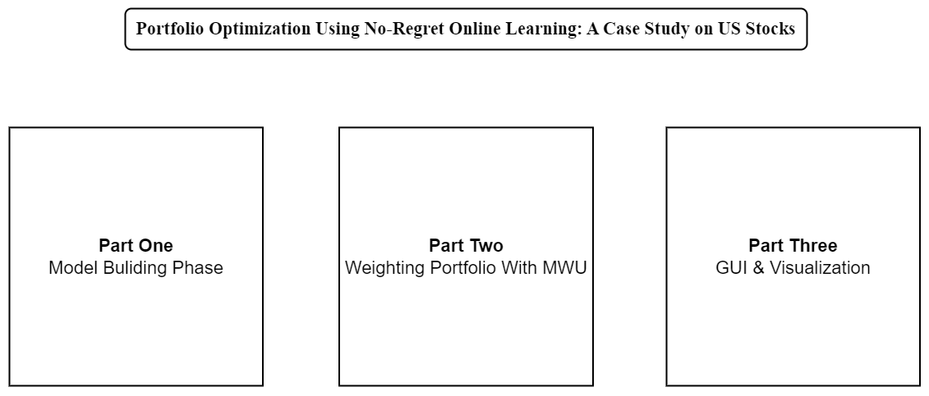
Flow Chart

Slide 4
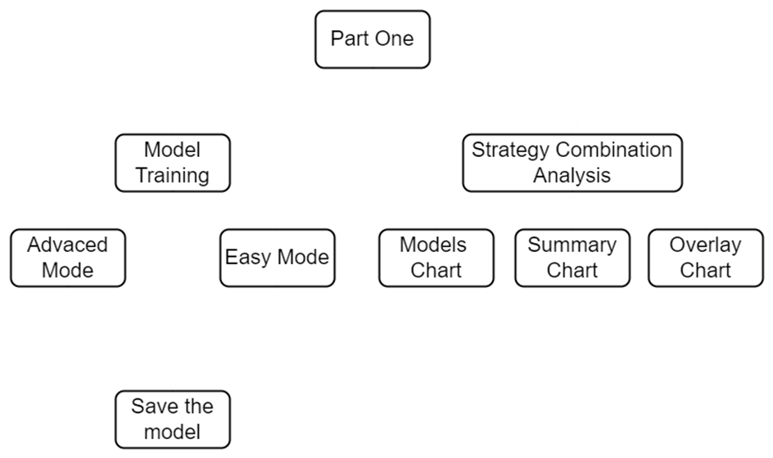
Part One Flow Chart

Slide 5
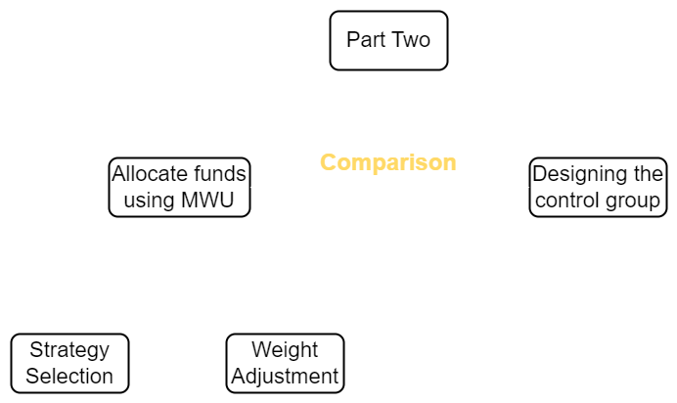
Part Two Flow Chart

Slide 6
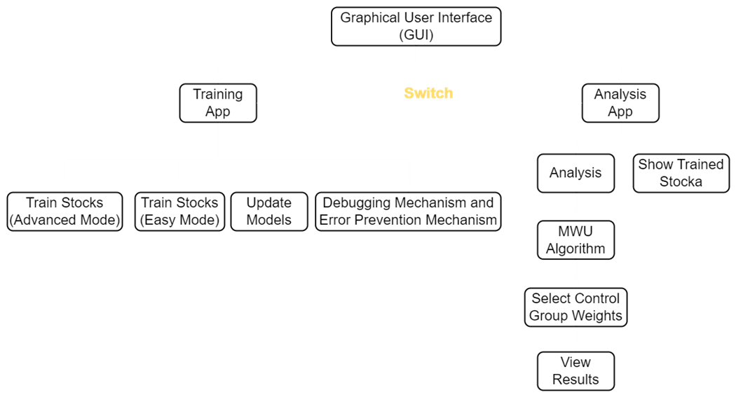
Part Three Flow Chart

Slide 7
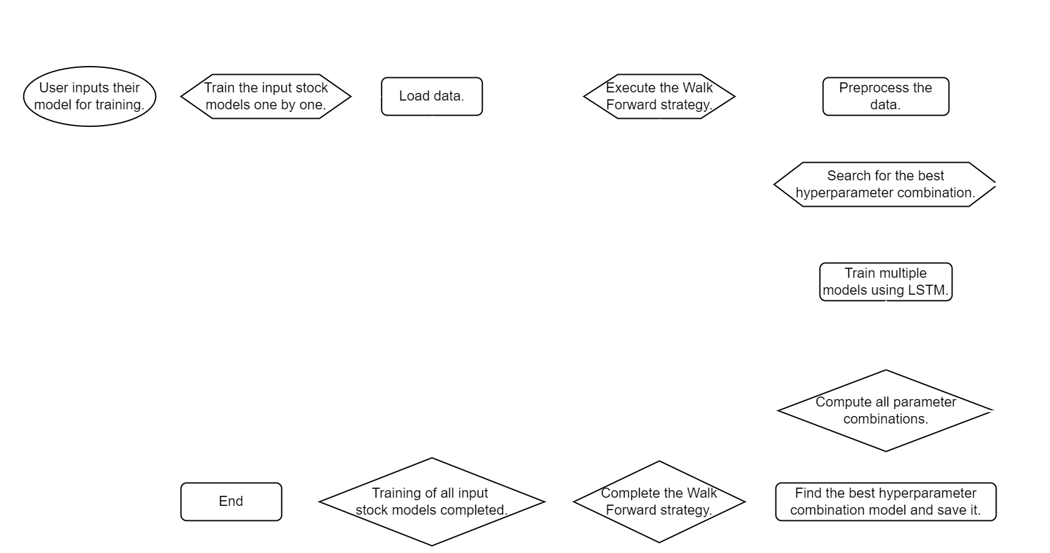
Model Training Flow Chart
Data Processing

Slide 8
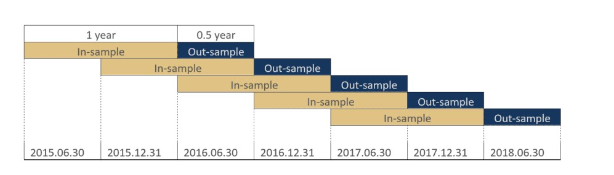
Data acquisition and preprocessing
Acquire and preprocess data from Yahoo Finance from 2009 to present.
Incorporate technical indicator features such as MACD, K, and WILLR to provide the model with more valuable feature columns, thus enhancing the predictive performance of the model.
Normalize the data.
Train the model internally using 10 days of data to predict the next day's closing price.
Using the Walk Forward strategy
Divide the dataset into multiple subsets and progressively train multiple models.
Train the model using only a portion of the data, then gradually move the data forward to train the next model.
Ability to evaluate the performance of the model in different time periods to ensure robustness and generalization ability of the model
(Walk Forward Diagram)

Slide 9
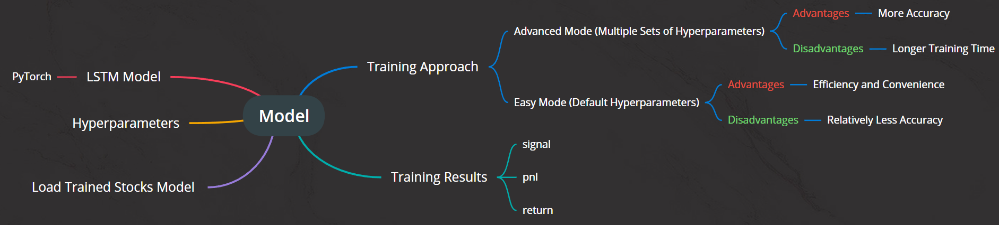
Model Processing

Slide 10
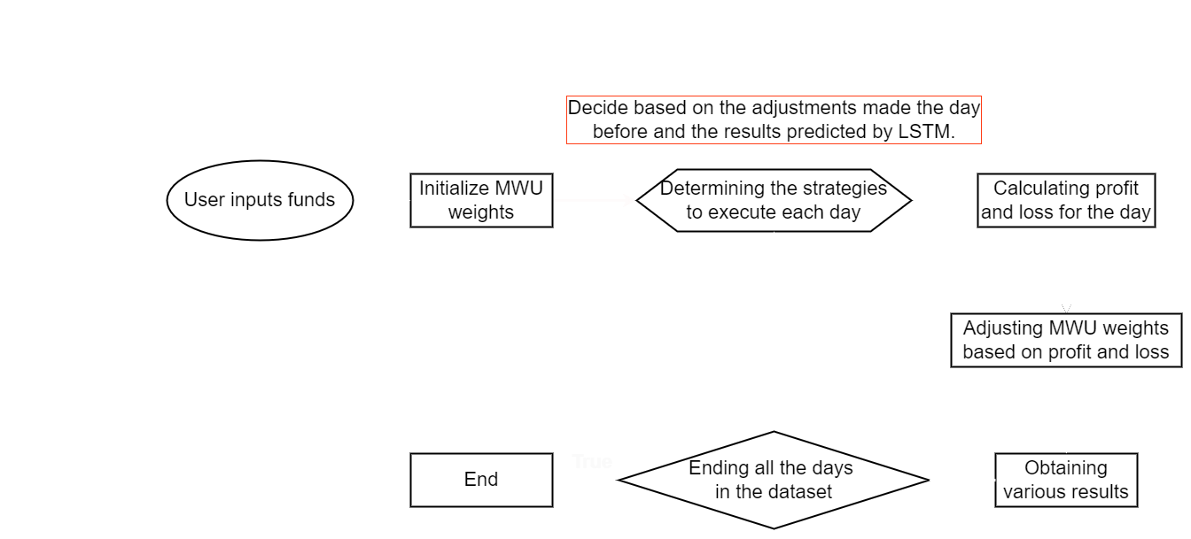
MWU Flow Chart

Slide 11
Multiplicative Weight Update algorithm (MWU)
Through strategy, calculate daily profits and losses and adjust weights. In each round, weights of underperforming decisions decrease to mitigate risk.
Proven as a form of fixed investment portfolio under hindsight conditions (control group), it may not perform better in the short term, but as time approaches infinity, its performance matches that of hindsight, hence termed the "no-regret algorithm."
Risk control, profit optimization, dynamic adaptation.
Furthermore, MWU has the advantage of being model-free (there is no need to train its parameters specifically for MWU).

Slide 12
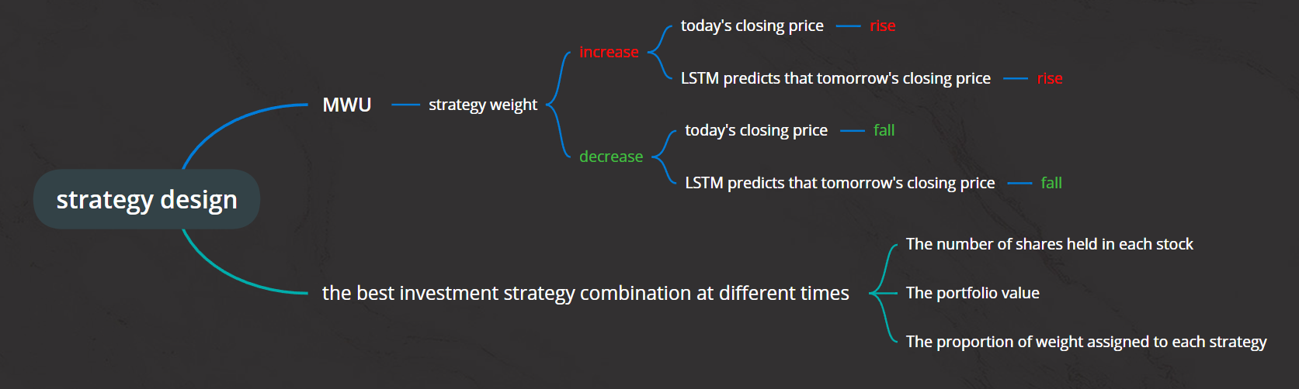
Our Designed Strategy
After trying different strategies, we eventually designed our strategy as follows:
If today's closing price rises (⭡) and the LSTM predicts that tomorrow's closing price will rise (⭡), the MWU will increase the weight of this strategy.
If today's closing price falls (⭣) and the LSTM predicts that tomorrow's closing price will fall (⭣), the MWU will decrease the weight of this strategy.
Finally, this allows us to find the best investment strategy combination at different times and determine the number of shares held in each stock, the Portfolio Value, and the proportion of weights allocated to each strategy.

Slide 13
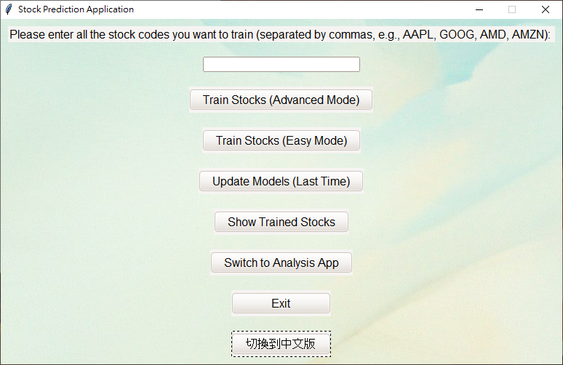
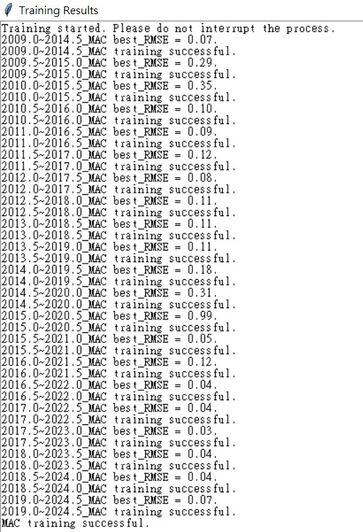
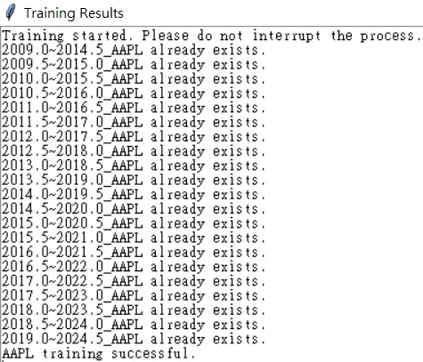
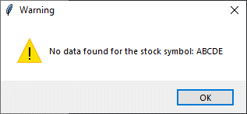
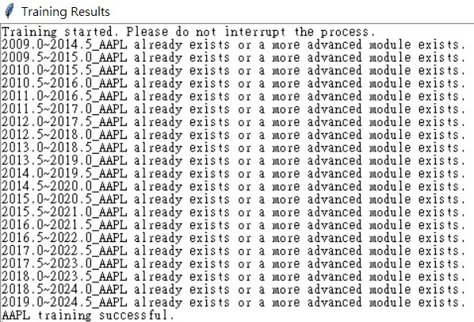
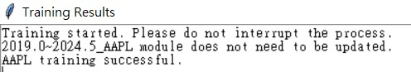
Graphical User Interface (GUI)
Training App
Implemented a comprehensive debugging mechanism to handle various situations that may occur during training.
Show Trained Stocks: The upper half will display stocks with advanced mode models, while the lower half will show stocks with easy mode models.
Switch to Analysis App: We set up a button to allow users to switch between the Training App and Analysis App.
Exit: Close the Training App.
切換到中文版: Switch to the Chinese version page.
First, enter the desired US stock symbol for training. If an invalid stock symbol is entered, an error message will be displayed.
Advanced Mode: Users can conduct hyperparameter tuning to find the optimal model configuration.
Easy Mode: Users can quickly obtain a model without selecting hyperparameters, meeting basic requirements.
Update Model: Users can train new models without having to retrain all existing models.

Slide 14
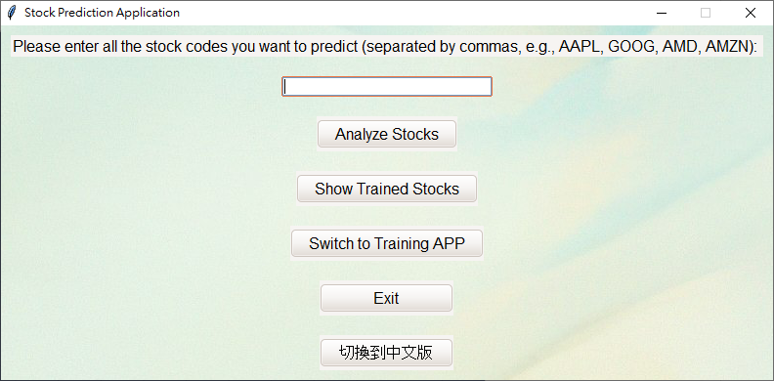
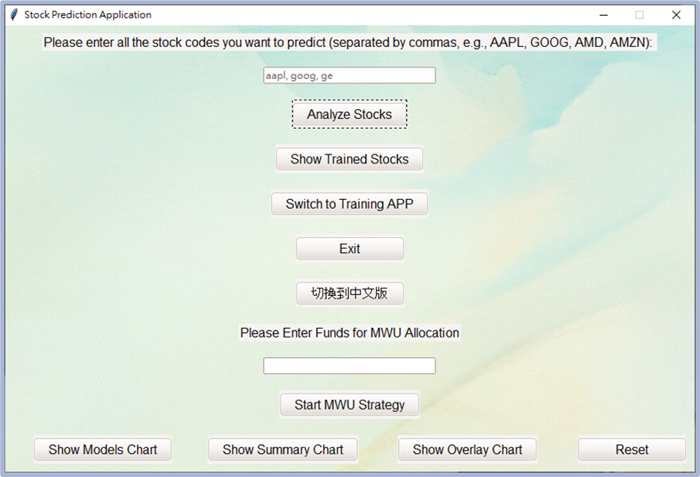
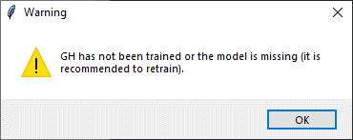
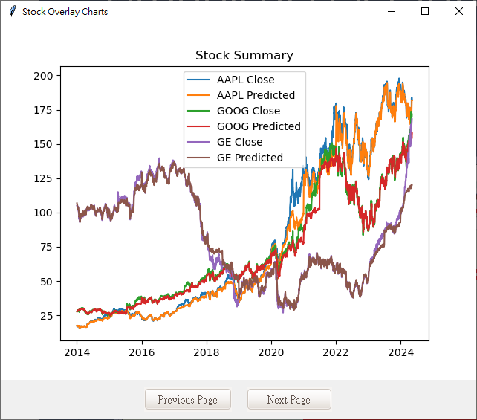
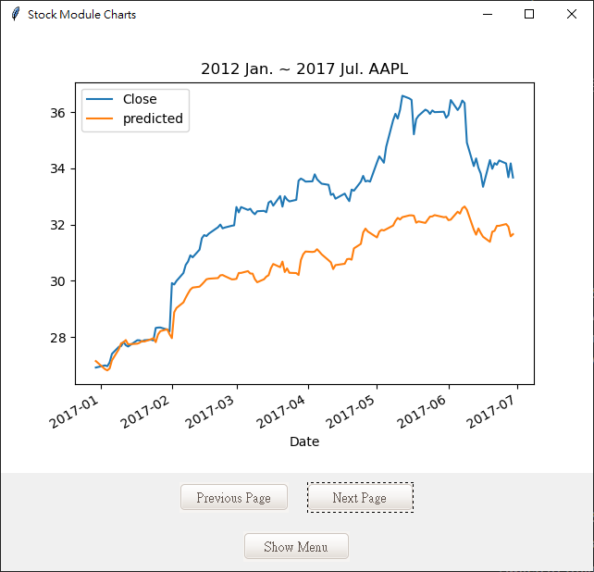
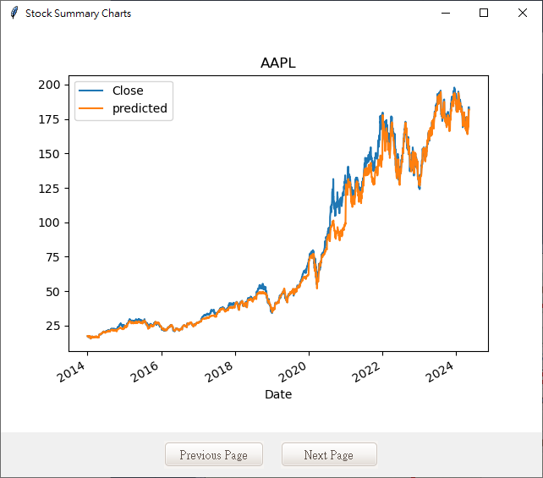
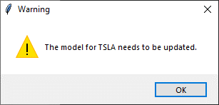
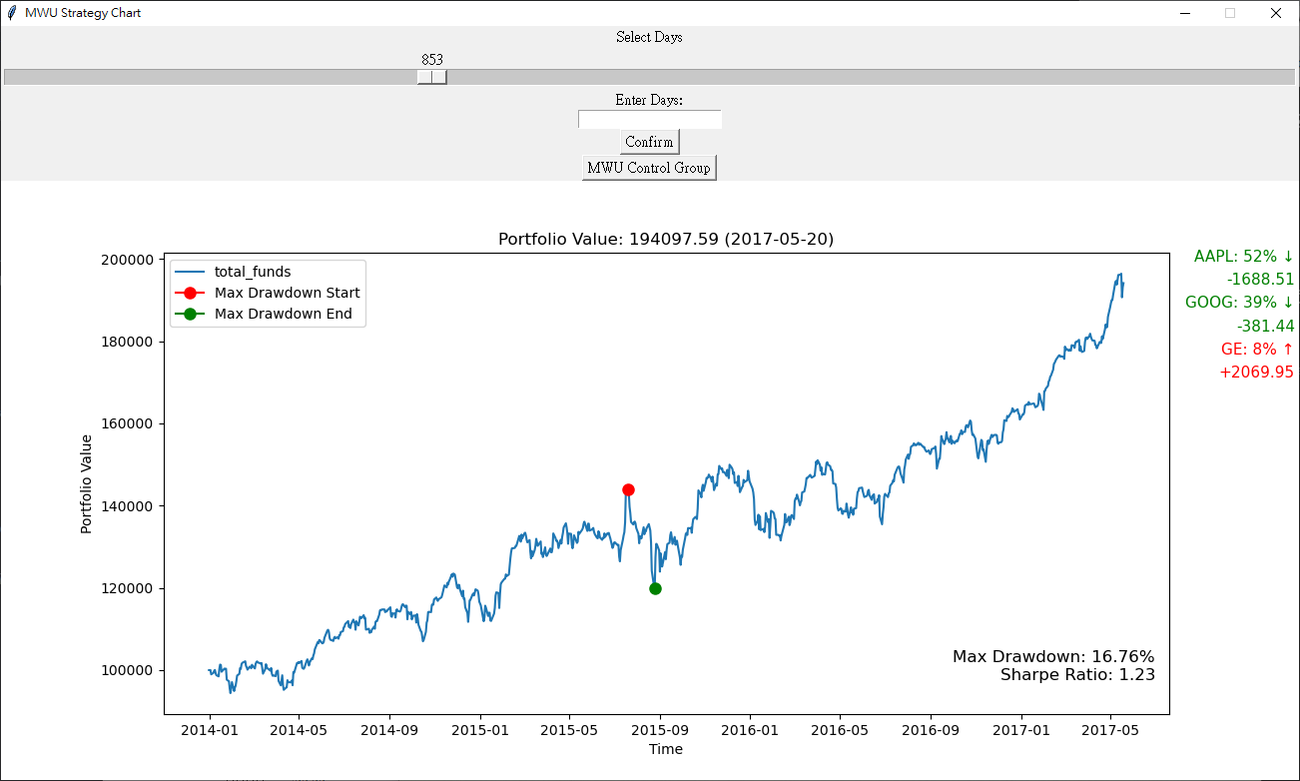
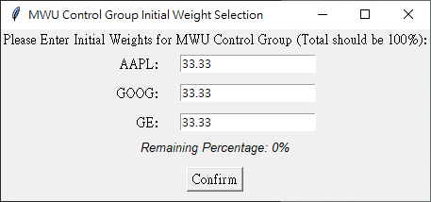
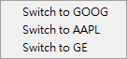
Graphical User Interface (GUI)
Analysis App
When the user inputs a US stock symbol that has not been trained yet, is unknown, or is missing the latest model, an error message will be displayed.
After analyzing the investment strategy combination, the user can input the total fund for investment. Upon activating the MWU strategy, users can choose the fixed weight allocation for the control group. Once selected, they can press "Confirm" to display the results of the MWU strategy.
Show Overly Chart: Combine the results of all US stock models and overlay the results of all stocks for comparison and observation.
Show Models Chart: Display the results of each model trained separately and provide a dropdown menu for users to quickly switch between them.
Show Summary Chart: Aggregate the results of all trained models to present the overall performance of a single stock.
Show Trained Stocks: The upper half will display stocks with advanced mode models, while the lower half will show stocks with easy mode models.
Switch to Training App: We set up a button to allow users to switch between the Training App and Analysis App.
Exit: Close the Analysis App.
切換到中文版: Switch to the Chinese version page.
Similarly, the user inputs multiple US stock symbols and clicks on "analyze“, but the entered stocks must have been trained previously.
Reset: After analysis, you need to click on "Reset" before proceeding to analyze the next strategy combination.
After entering a trained model that does not need updating, the results will appear after the analysis is completed.
Dropdown Menu

Slide 15
DEMO

Slide 16
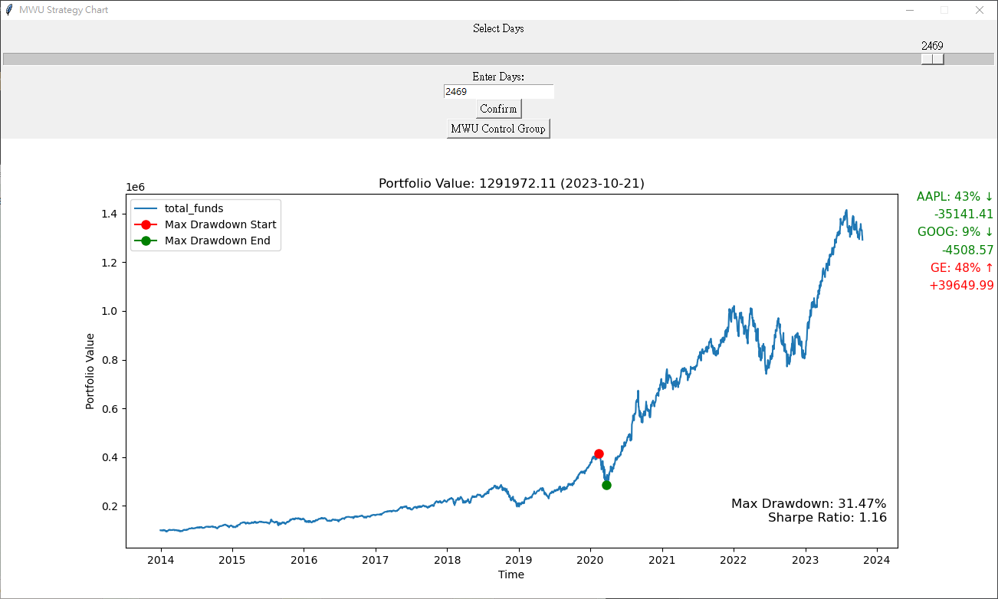
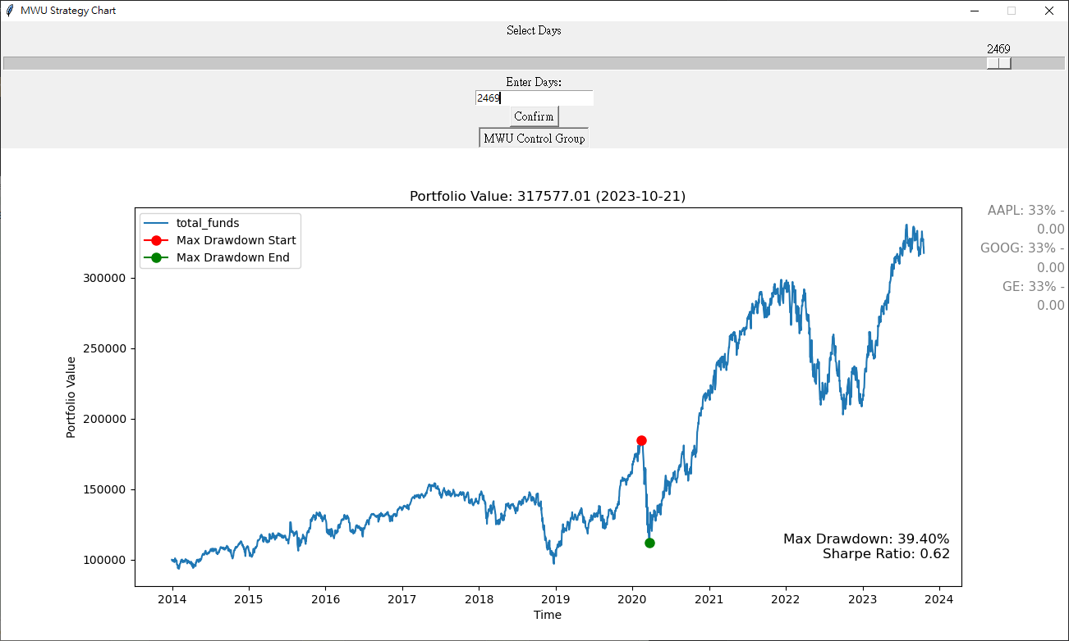
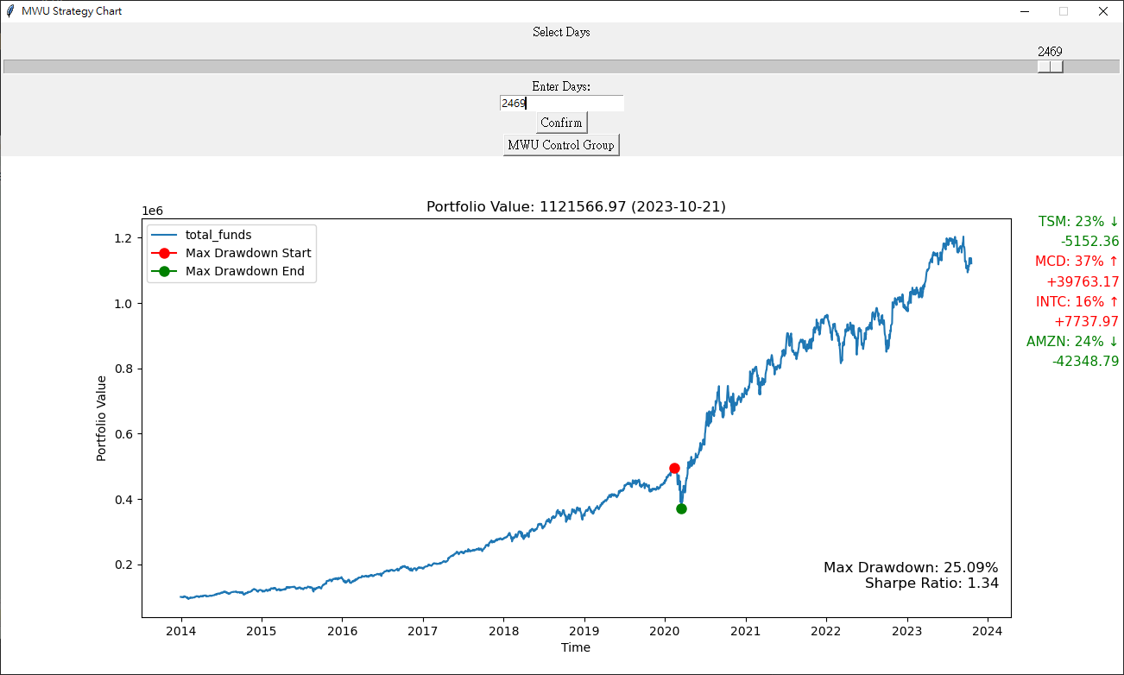
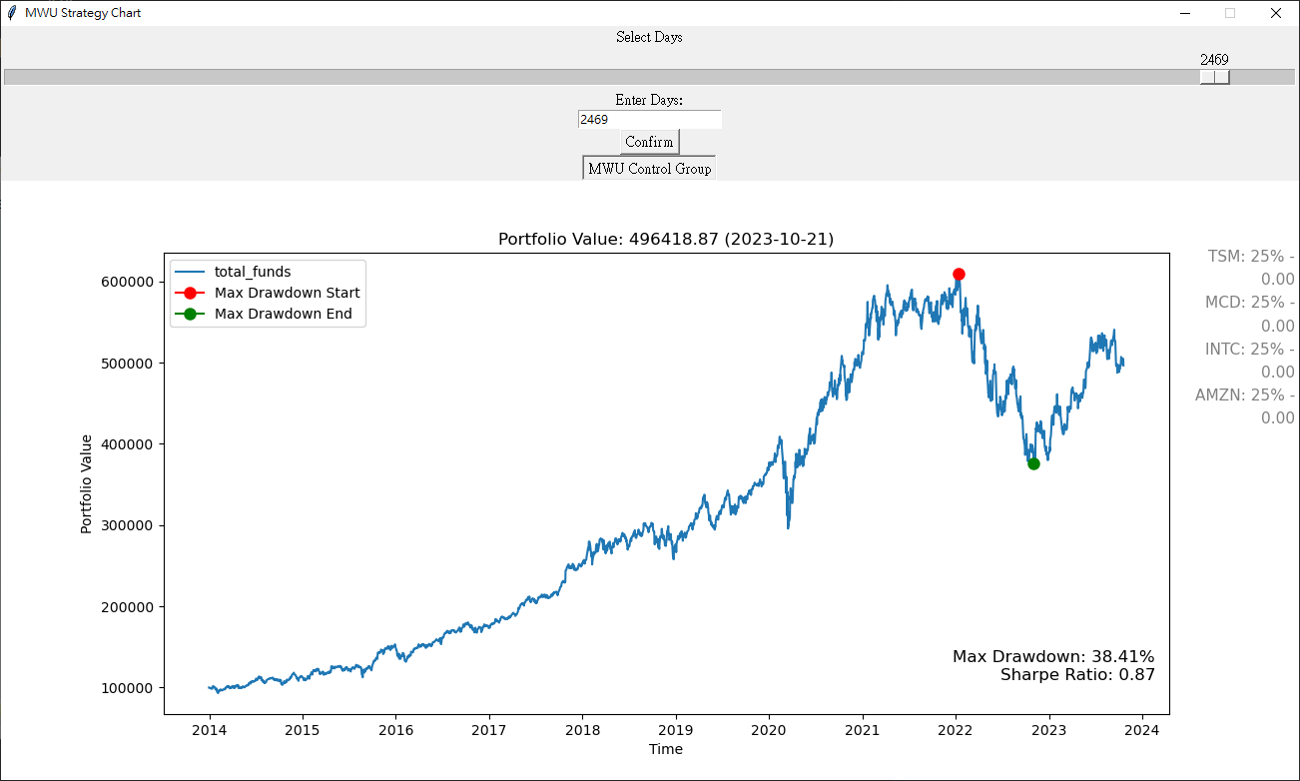
Result Analysis
Through our testing, we've found that the majority of investment portfolios with inferior strategies, after prolonged adjustments, tend to perform better using the MWU strategy compared to the control group. This confirms the no-regret characteristic demonstrated by MWU.
Experimental group
Control group
AAPL, GOOG, GE
TSM, MCD, INTC, AMZN

Slide 17
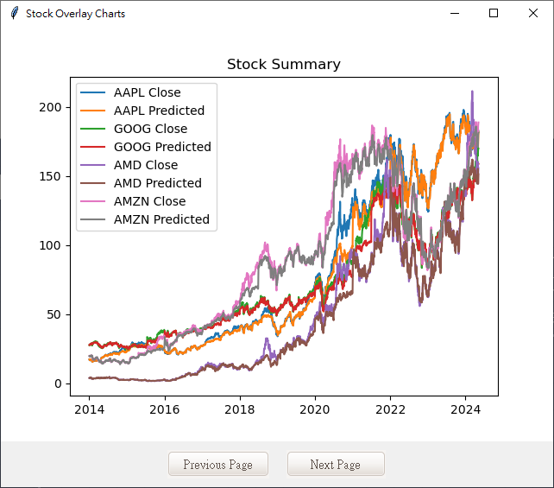
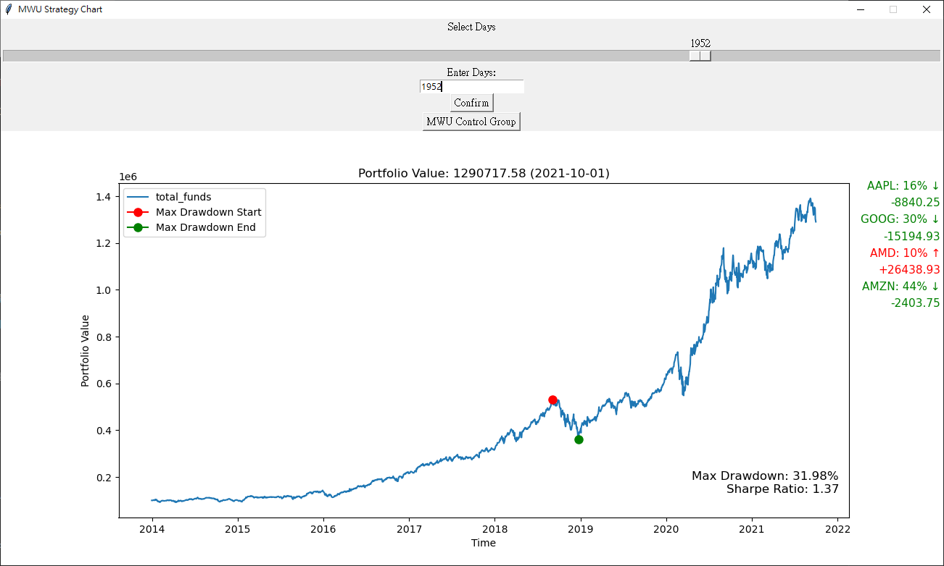
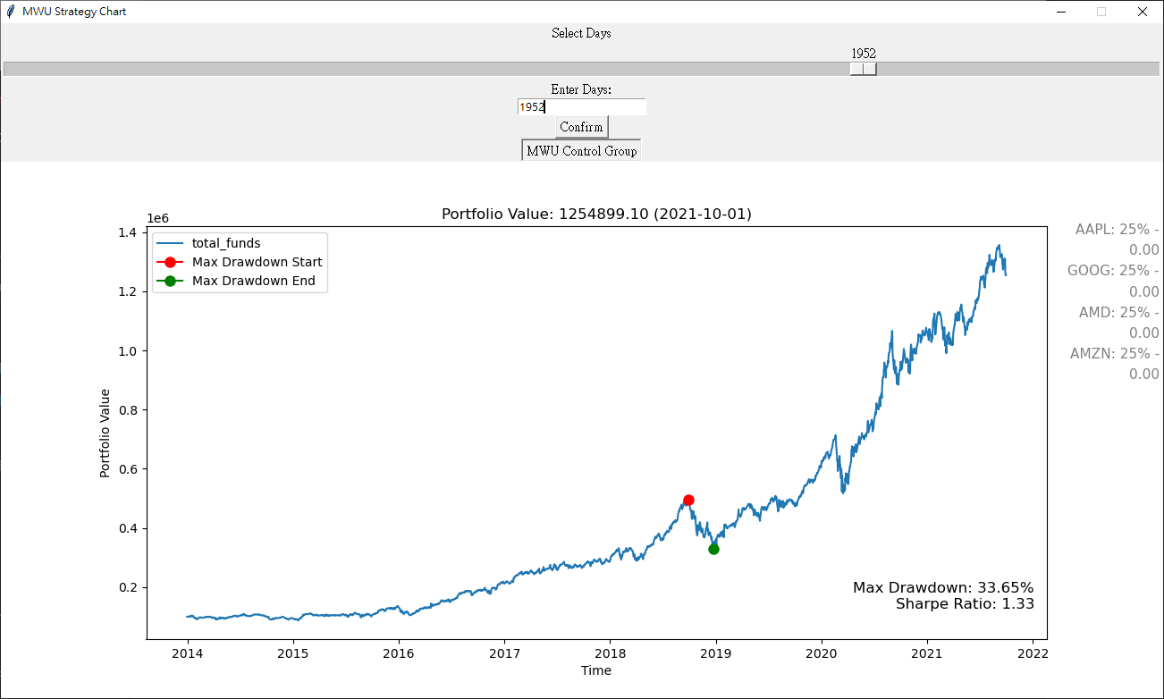
Result Analysis
MWU primarily helps us avoid risks, so when all selected strategies have similar trends, the effectiveness of MWU may not be evident. For example, when we choose AAPL + GOOG + AMD + AMZN, all with upward trends, the trends of these four strategies are very similar, as shown in the graph below.
AAPL, GOOG, AMD, AMZN AMZN
Experimental group
Control group
As can be seen from the chart above, at this point, it's difficult to highlight the effectiveness of MWU.

Slide 18
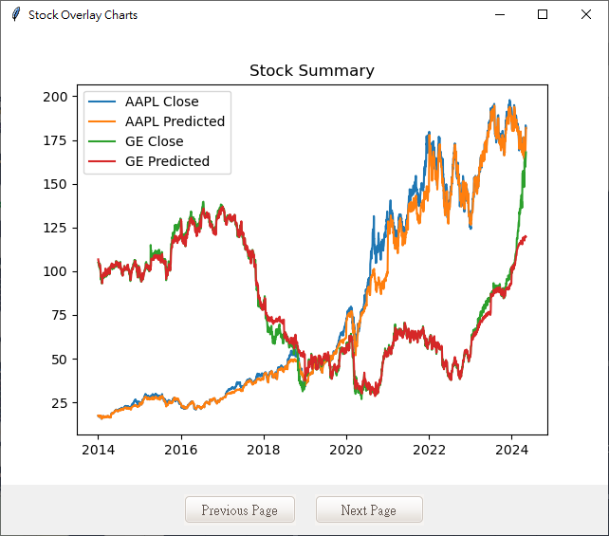
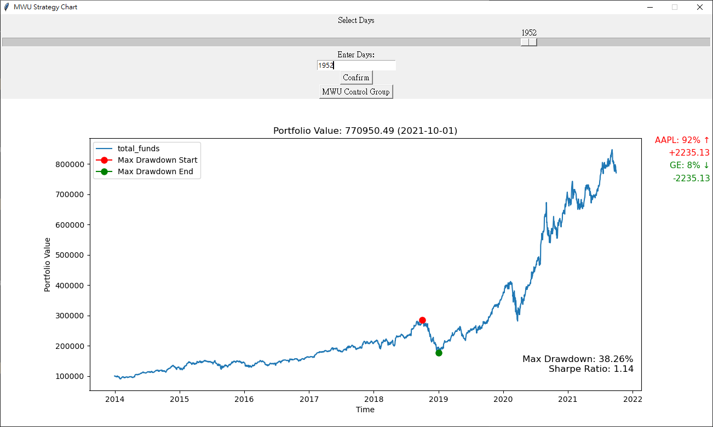
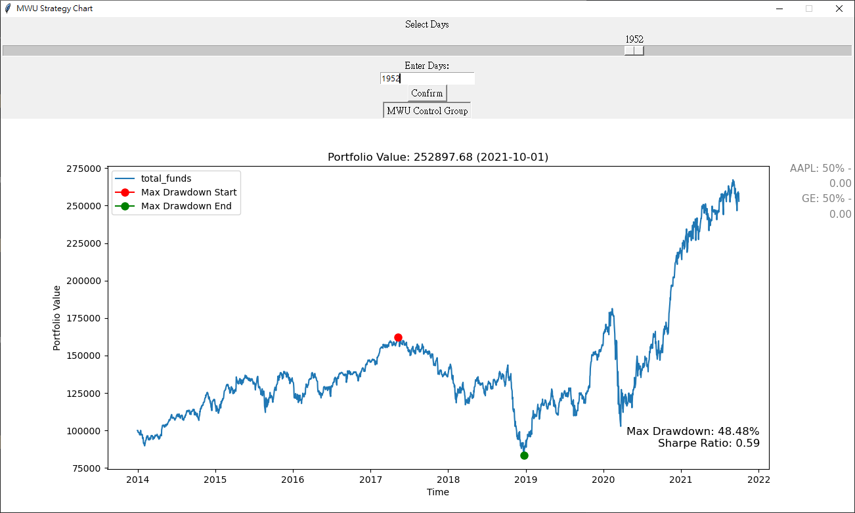
Result Analysis
If AAPL + GE are chosen as the investment strategy combination, since the stock trends of these two are opposite, one rising and one falling, MWU's effect can be demonstrated very effectively here by concentrating weights on specific strategies.
AAPL, GE
Experimental group
Control group
As evident from the chart above, MWU has played a significant role here, achieving the desired risk avoidance effect.

Slide 19
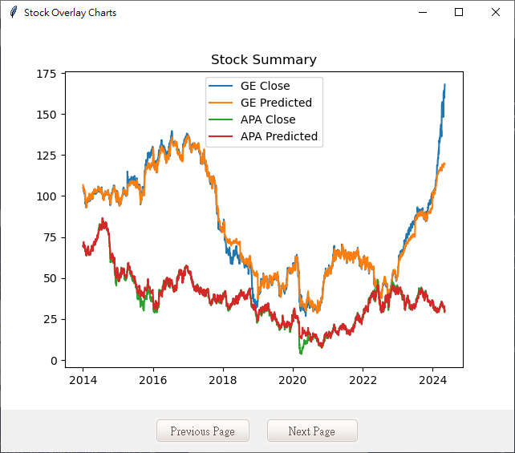
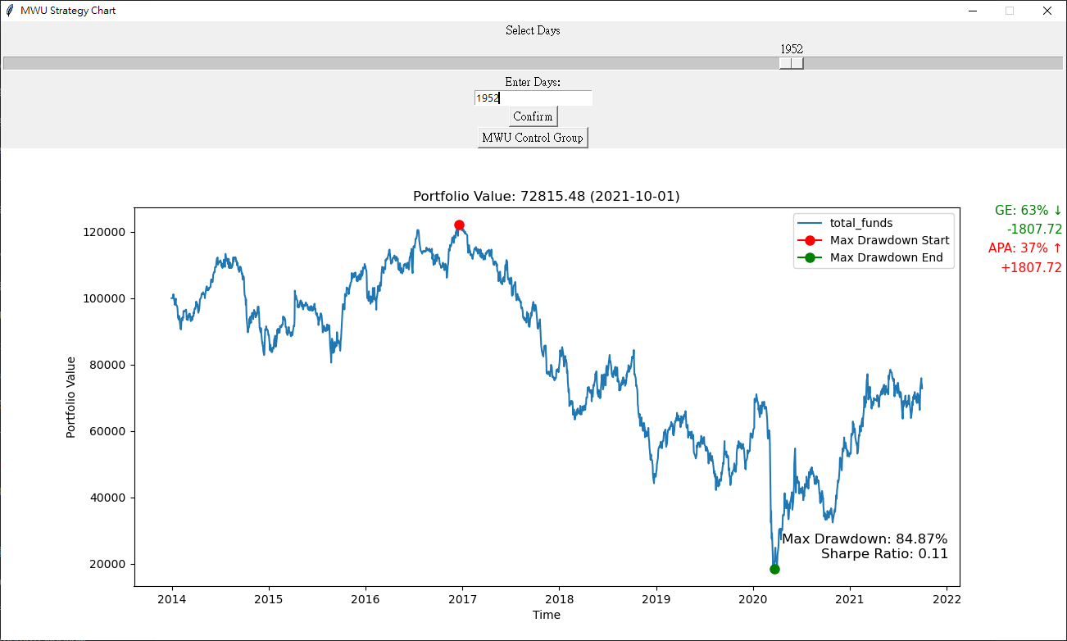
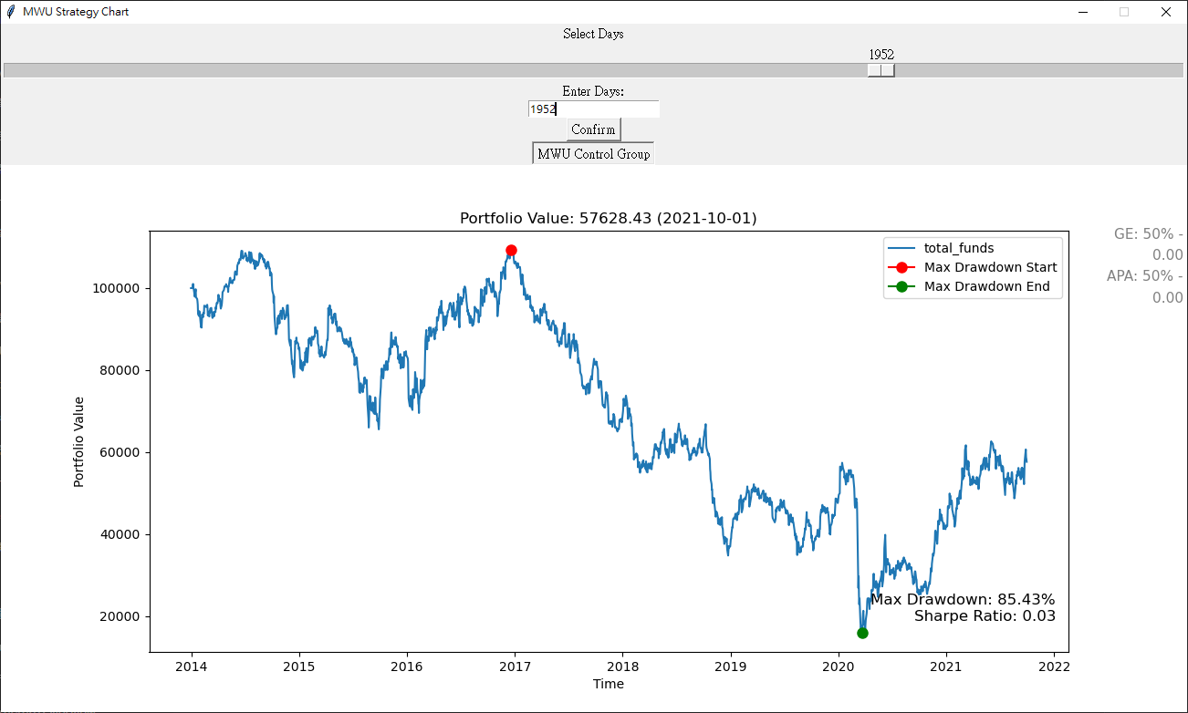
Result Analysis
When we select an investment strategy combination where all stocks are declining, and we choose to allocate all funds into stocks, regardless of how MWU allocates the fund proportions, we will still incur losses. However, MWU can effectively reduce the magnitude of losses compared to the control group.
GE, APA
Experimental group
Control group
Since the selected strategies have similar trends, the effectiveness of MWU may not be pronounced. However, as mentioned earlier, MWU can still help us incur relatively fewer losses.

Slide 20
Conclusion
The results obtained from training an LSTM model may deviate from the actual situation, but they often exhibit similar trends. This is why we integrate LSTM results into the MWU strategy design, which helps optimize strategy selection and improve investment efficiency.
After comparing, it's evident that in the vast majority of investment portfolios, the results of the MWU strategy outperform those of the control group, especially after prolonged periods of adjustment, demonstrating the effectiveness of MWU.
Our future plan
Considering scenarios where not all funds are invested: short selling, day trading, etc.
Dynamically adjusting strategies based on user choice and current conditions.
Implementing real investments and analyzing their effectiveness.

Slide 21
Thank you for your patience.

Slide 22


-Supervising Teacher-
Chih-Chieh Hung
Associate Professor,
Department of Management Information Systems, National Chung Hsing University
Chuang-Chieh Lin
Assistant Professor,
Department of Computer Science and Information Engineering, Tamkang University
-Team Members-
Shuo-Ting Hung, Pin-Hua Wei, Yu-Chuan Huang, Nan-Tien Chen, Han-Siang Lan
Department of Computer Science and Information Engineering, Tamkang University

